Slide 1
Week 3 - Perspective and Foregrounding
in the Topic of Construal
LT3234 Language and Cognition
Alan SIN Man Long (54339418)
Gigi WONG Man Chi (5403 3000)
Mia WAN Yuwei(5438 2027)
Muriel LEUNG Sin Yee (5479 7429)
Kenix Tai Wing Lam (54915198)

Slide 2
1.
Introduction

Slide 3
Agenda
Introduction
2.
What is “construal” ?
3.
Perspective
4.
Foregrounding
5.
Applications to other languages
6.
Conclusion

Slide 4
2.
What is “construal”?

Slide 5
“Construal” has two parts of meaning
Notes:
The very first question that the study of Language and Cognition asks is how human beings perceive and construe the external world. So the word “construal” is very important in the study of Language and Cognition. We are going to define it first.

Slide 6
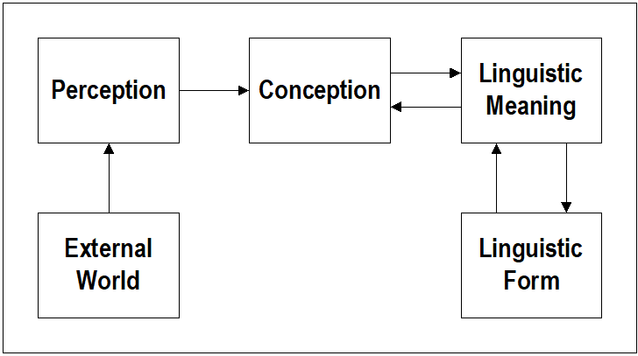
INTERPRETATION
1st Part:
How we construct the external world in our minds
Notes:
When we see a “book”, we’ll first perceive the image of a book and then formulate a mental construction of this object in our mind, during this stage.

Slide 7
2. EXPRESSION
2nd Part:
How we linguistically express that mental construct
Notes:
After forming a conception, we need a linguistic form to express, so we’ll say that this is a “book”.

Slide 8
But why may we have different construals for the same situation?
Perspective
Foregrounding
Metaphor
Frame

Slide 9
3.
Perspective

Slide 10
Perspective
Viewpoints of
Relative Positions

Slide 11
Position
Relative
Spatial references
In comparison to
To the LEFT of ME.
To the RIGHT of YOU.
X is (position) (in comparison to) Y.

Slide 12
Relative Positions - Spatial
X is (position) (in comparison to) Y.
I am to the left of you.
You are to the right of me.
I am to the left of this building.
(?) This building is to the right of me.

Slide 13
Relative Positions - Spatial
Reference Points
Landmark
Large and conspicuous
Trajector
Smaller and more mobile
The tourists are in front of the van.
The van is in front of the pyramid.

Slide 14
Relative Positions - Temporal
point of reference
(Y axis)
Typewriters were before my time.
I was born after the time of typewriters.
Harrison died just 30 days after moving into the White House.
(?) Harrison moved into the White House just 30 days before he died.
Timelines
(X axis)

Slide 15
4.
Foregrounding

Slide 16

Foregrounding
the relative prominence of the various components
the most central or important ideas / clause in text
The FOCUS!

Slide 17

Foregrounding & Backgrounding
John set fire to a house.
Foreground: The role of John Background: John’s involvement in the event

Slide 18

Foregrounding
John set fire to the house.
A match set fire to the house.

Slide 19
More examples
Mary killed John with a knife. Mary used a knife to kill John.

Slide 20
5.
Applications to other Languages

Slide 21

Other Languages - Mandarin
After comparison, we found that some examples in Mandarin can also be explained by perspective and foregrounding.
Example 1 - perspective:
a. 小红比小明瘦 b.小明比小红胖
a: From perspective of 小红, 小明 is a reference------A thin girl 小红
b: From perspective of 小明, 小红 is a reference------A fat boy 小明

Slide 22


Other Languages - Mandarin
Example 2 - foregrounding:
a.他們在山上 b.他們在山裏
a: 山上-山下, focus on height
b: 山裏-山外, focus on location
---->may also refer to different kinds/sizes of mountain and location of speaker

Slide 23

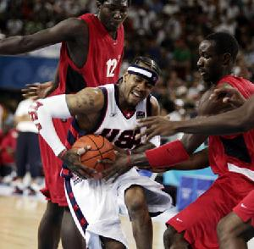

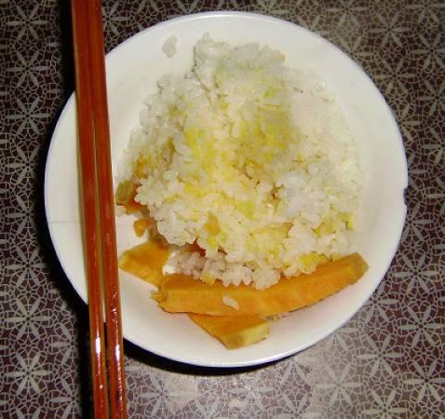
Other Languages - Mandarin
However, Mandarin may have some other ways to facilitate construal.
Extension:
他們買了一個籃球
他們比/打了一場籃球
Specific reference:
你吃飯了嗎
你飯吃了嗎

Slide 24
Other Languages - Cantonese
The role of “me” is foregrounded.
個甜品 係 我 用 面粉同朱古力 整的。
It is me who make the dessert by using flour and chocolate.
個甜品 係 用 面粉同朱古力 整的。
The dessert is made of flour and chocolate.
The dessert
is
I
used
flour and chocolate
to make
The elements of the dessert is foregrounded.
The dessert
is
by using
flour and chocolate
to make

Slide 25
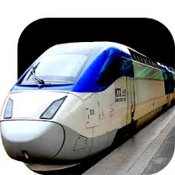

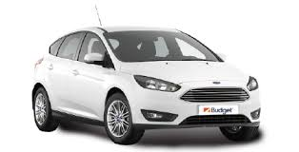
Other Languages - Korean and Japanese
There are some languages which have specific particles to highlight the perspective in the following case.
비행기가 기차보다 빨라요.
The particle “가” tells that
this sentence is from the
perspective of 비행기.
地下鉄は 車より 速いです。
The particle “は” tells that
this sentence is from the
perspective of 地下鉄.
기차
비행기
Faster
빨라요
地下鉄
車
Faster
速いです

Slide 26
6.
Conclusion

Slide 27
Conclusion
Construal is the interpretation and expression of concepts
Interpretation means to perceive and construct
A person’s cognition is reflected through linguistic expressions
There are various strategies of how expressions can be delivered, two of which are the use of perspectives and foregrounding
Perspectives are the viewpoints of relative positions
Foregrounding is the intentional effort made to give varying prominence to the components in
an expression

Slide 28
THANKS!
😉
Any questions?

Slide 29
Reference
Fang, A. (2018). Language and Cognition Session 1: Introduction [Powerpoint slides], p.39.

